Slide 1

Chapter 2.2
Probabilities and Random Variables
Performance Evaluation of the Internet of Things (IoT)
Module Course: Performance Evaluation of Distributed Systems
Prof. Tobias Hoßfeld, Summer Semester 2022

Slide 2
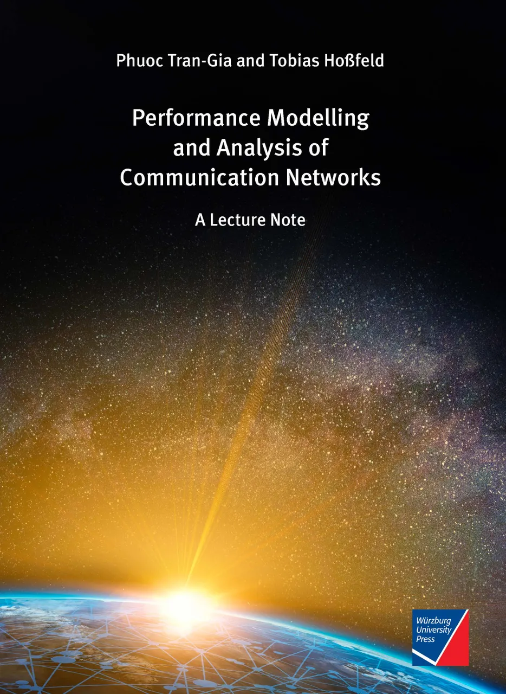
Disclaimer and Copyright Notice
Lecture slides, figures, and scripts are based on the open access text book “Performance Modeling and Analysis of Communication Networks”. The book and scripts are licensed under the Creative Commons License Attribution-ShareAlike 4.0 International (CC BY-SA 4.0). If you remix, transform, or build upon the material, you must distribute your contributions under the same license as the original.
The book must be cited and the disclaimer attached when using lectures slides or scripts.
Tran-Gia, P. & Hossfeld, T. (2021). Performance Modeling and Analysis of Communication Networks - A Lecture Note. Würzburg University Press. https://doi.org/10.25972/WUP-978-3-95826-153-2
Website to download book, exercises, slides and scripts: https://modeling.systems/

Slide 3
Chapter 2
2 Fundamentals and Prerequisites
2.1 Little’s Theorem and General Results
2.1.1 Little’s Law in Finite Systems with Blocking
2.1.2 Example: Multiclass Systems
2.1.3 Example: Balking
2.1.4 The Utilization Law
2.1.5 Assumptions and Limits of Little’s Law
2.1.6 General Results for GI/GI/n Delay Systems
2.1.7 Loss Formula for GI/GI/n-S Loss Systems
2.2 Probabilities and Random Variables
2.2.1 Random Experiments and Probabilities
2.2.2 Other Terms and Properties
2.2.3 Random Variable, Distribution, Distribution Function
2.2.4 Expected Value and Moments
2.2.5 Functions of Random Variables and Inequalities
2.2.6 Functions of Two Random Variables
2.3 Transform Methods
2.3.1 Generating Function
2.3.2 Laplace and Laplace-Stieltjes Transforms
2.4 Some Important Distributions
2.4.1 Discrete Distributions
2.4.2 Continuous Distributions
2.4.3 Relationship between Continuous and Discrete Distribution

Slide 4
Random Experiments and Probabilities

Slide 5
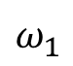
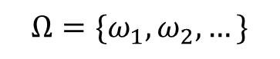
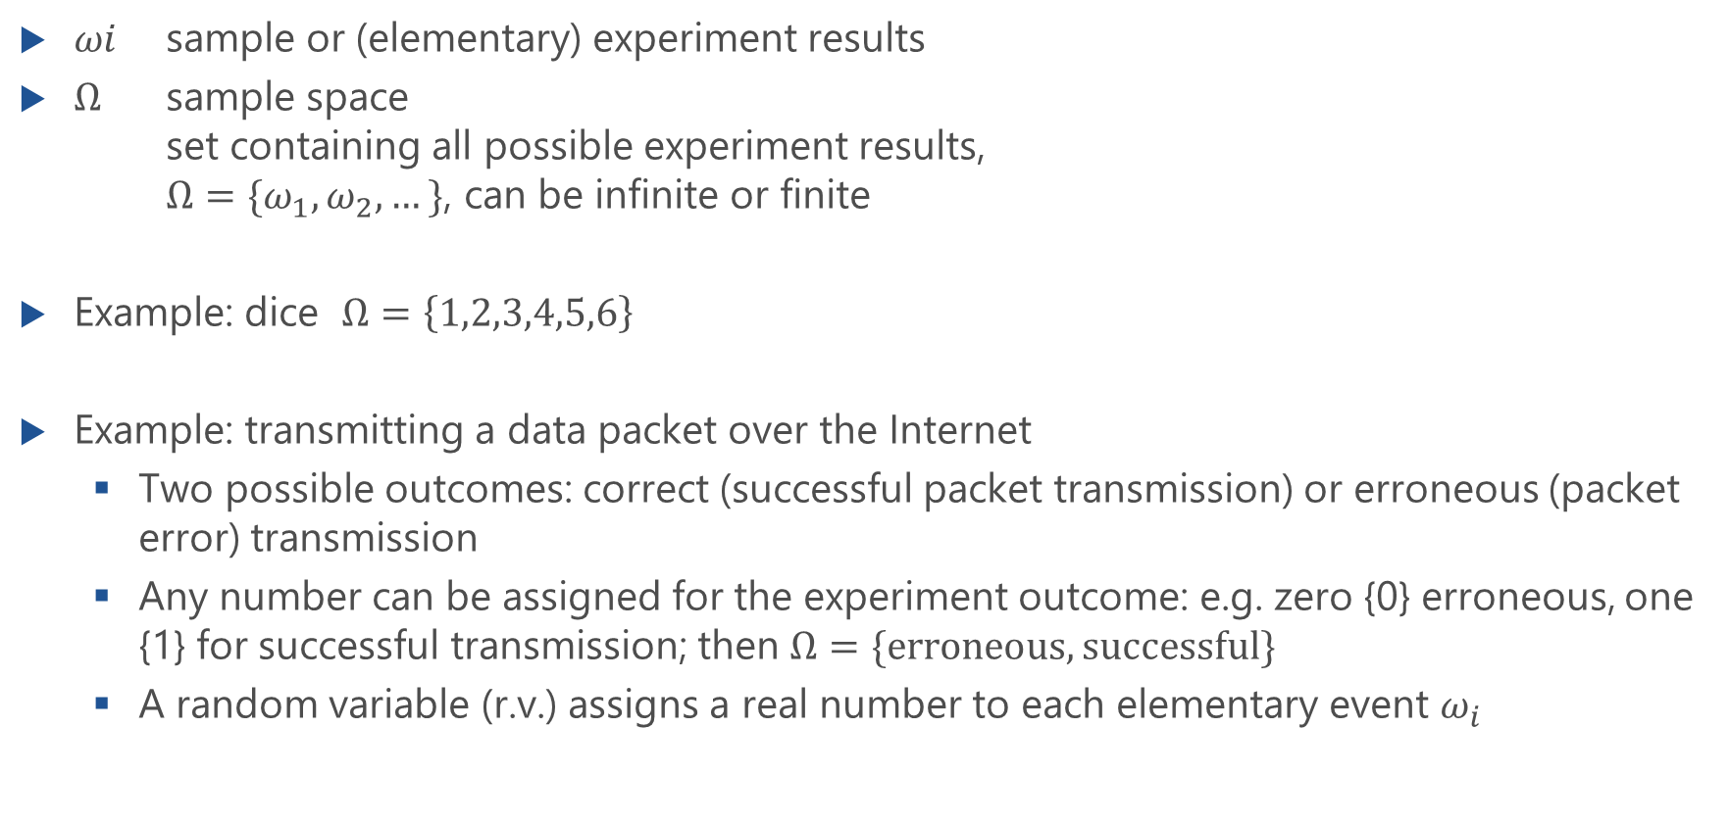
Random Events
$ωi$ sample or (elementary) experiment results
$Ω$ sample space set containing all possible experiment results, $Ω=\{ω_{1},ω_{2}, …\}$, can be infinite or finite
Example: dice $Ω=\left\{1,2,3,4,5,6\right\}$
Example: transmitting a data packet over the Internet
Two possible outcomes: correct (successful packet transmission) or erroneous (packet error) transmission
Any number can be assigned for the experiment outcome: e.g. zero {0} erroneous, one {1} for successful transmission; then $Ω=\{erroneous,successful\}$
A random variable (r.v.) assigns a real number to each elementary event $ω_{i}$
$$Ω=\{ω_{1},ω_{2}, …\}$$
$$ω_{1}$$

Slide 6
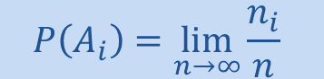

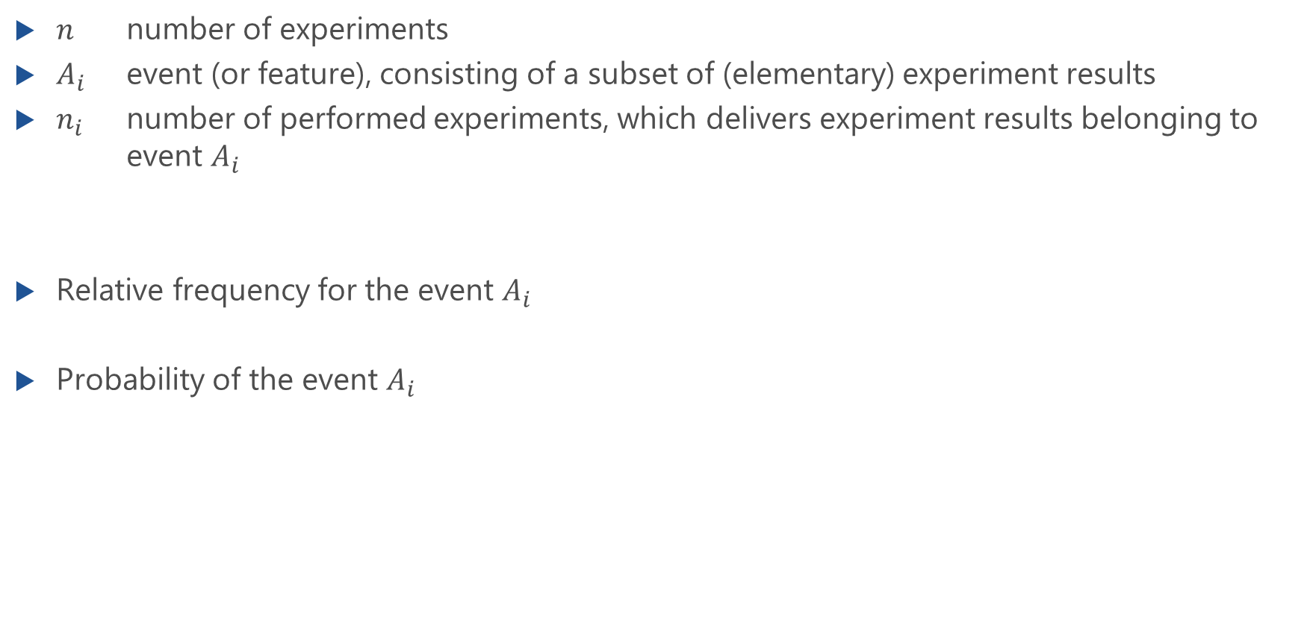
Probability as Limit of Relative Frequency
$n$ number of experiments
$A_{i}$ event (or feature), consisting of a subset of (elementary) experiment results
$n_{i}$ number of performed experiments, which delivers experiment results belonging to event $A_{i}$
Relative frequency for the event $A_{i}$
Probability of the event $A_{i}$
$$h\left(A_{i}\right)=\frac{n_{i}}{n}$$
$$P\left(A_{i}\right)=\lim_{n→∞}{\frac{n_{i}}{n}}$$

Slide 7
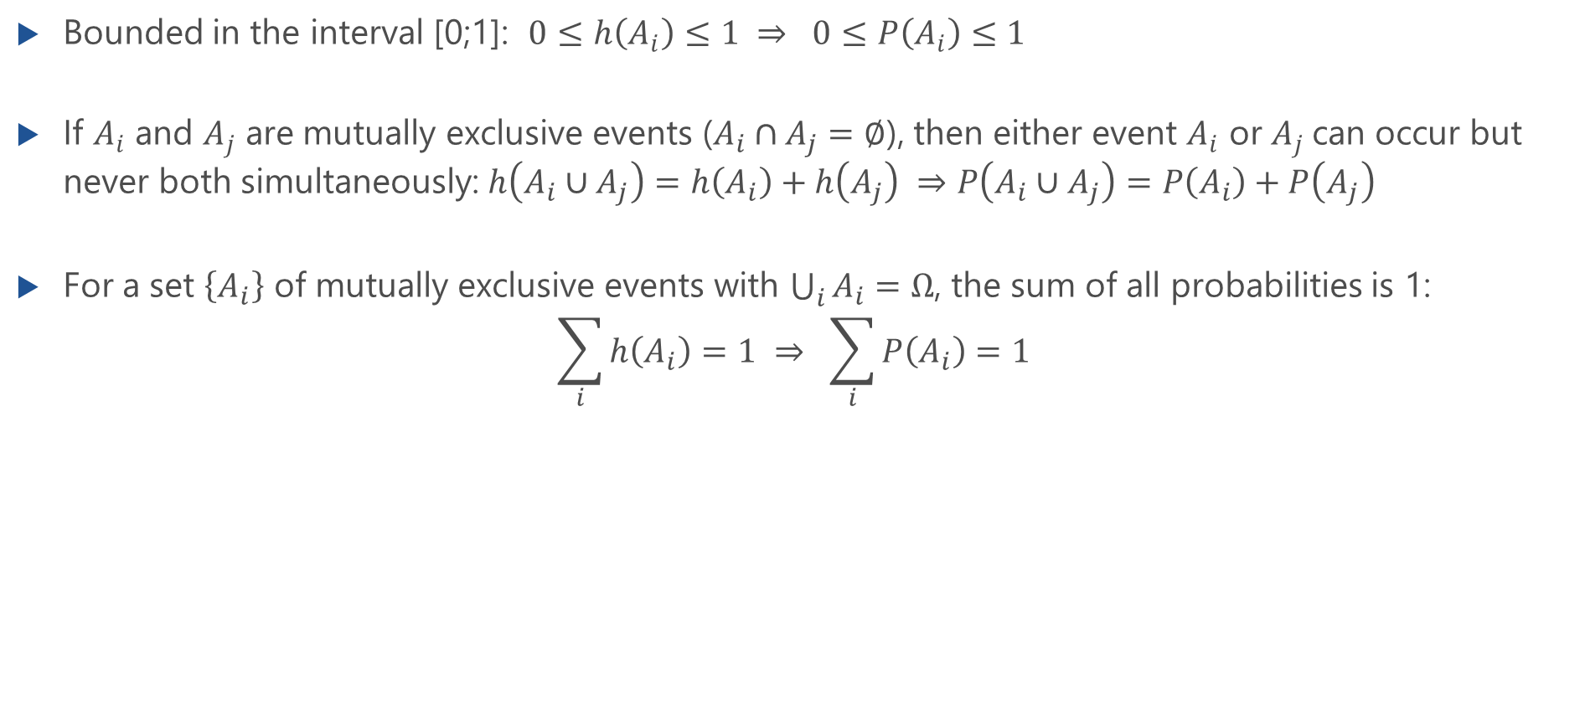
Properties of the Probability of an Event
Bounded in the interval [0;1]: $0≤h\left(A_{i}\right)≤1 ⇒ 0≤P\left(A_{i}\right)≤1$
If $A_{i}$ and $A_{j}$ are mutually exclusive events ($A_{i}∩A_{j}=∅$), then either event $A_{i}$ or $A_{j}$can occur but never both simultaneously: $h\left(A_{i}∪A_{j}\right)=h\left(A_{i}\right)+h\left(A_{j}\right) ⇒P\left(A_{i}∪A_{j}\right)=P\left(A_{i}\right)+P\left(A_{j}\right)$
For a set $\left\{A_{i}\right\}$ of mutually exclusive events with $\bigcup_{i}{A_{i}}=Ω$, the sum of all probabilities is 1: $\sum_{i}{h\left(A_{i}\right)=1 ⇒ \sum_{i}{P\left(A_{i}\right)=1}}$

Slide 8


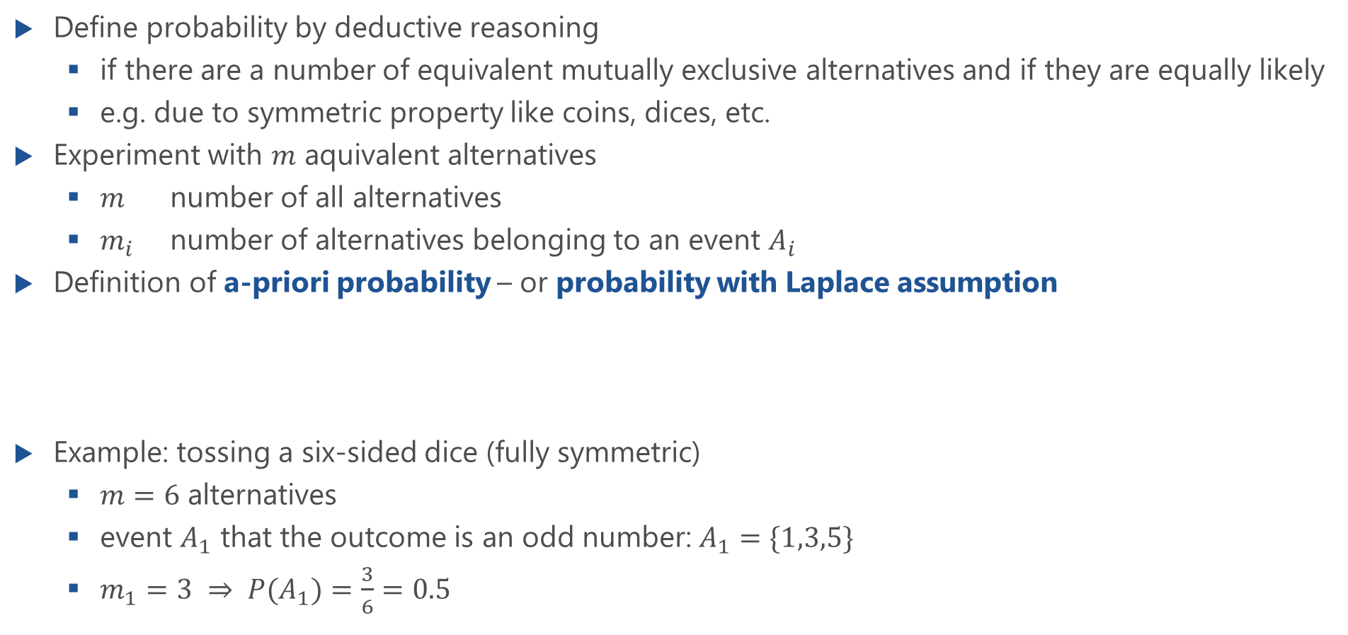
A-priori Probability
Define probability by deductive reasoning
if there are a number of equivalent mutually exclusive alternatives and if they are equally likely
e.g. due to symmetric property like coins, dices, etc.
Experiment with $m$ aquivalent alternatives
$m$ number of all alternatives
$m_{i}$ number of alternatives belonging to an event $A_{i}$
Definition of a-priori probability – or probability with Laplace assumption
Example: tossing a six-sided dice (fully symmetric)
$m=6$ alternatives
event $A_{1}$ that the outcome is an odd number: $A_{1}=\{1,3,5\}$
$m_{1}=3 ⇒ P(A_{1})=\frac{3}{6}=0.5$
$$P\left(A_{i}\right)=\frac{m_{i}}{m}$$

Slide 9
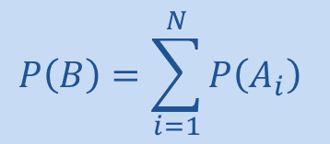
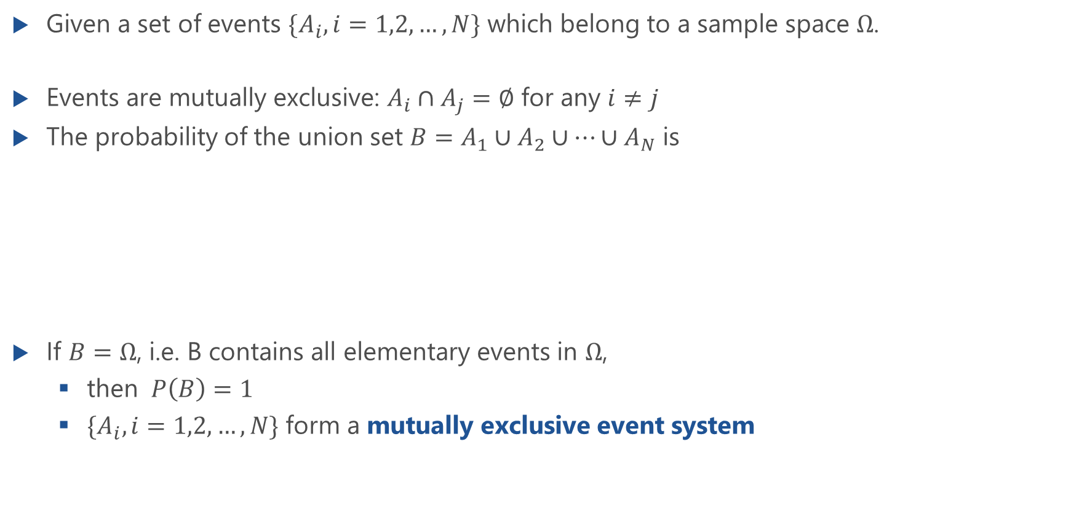
Mutually Exclusive Event System
Given a set of events $\{A_{i}, i=1,2,…,N\}$ which belong to a sample space $Ω$.
Events are mutually exclusive: $A_{i}∩A_{j}=∅$ for any $i≠j$
The probability of the union set $B=A_{1}∪A_{2}∪…∪A_{N}$ is
If $B=Ω$, i.e. B contains all elementary events in $Ω$,
then $P\left(B\right)=1$
$\{A_{i}, i=1,2,…,N\}$ form a mutually exclusive event system
$$P\left(B\right)=\sum_{i=1}^{N}{P\left(A_{i}\right)}$$
B
A_{N}
A₁
…
A₂
A_{i}
…

Slide 10
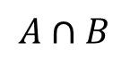
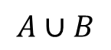
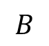
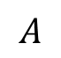
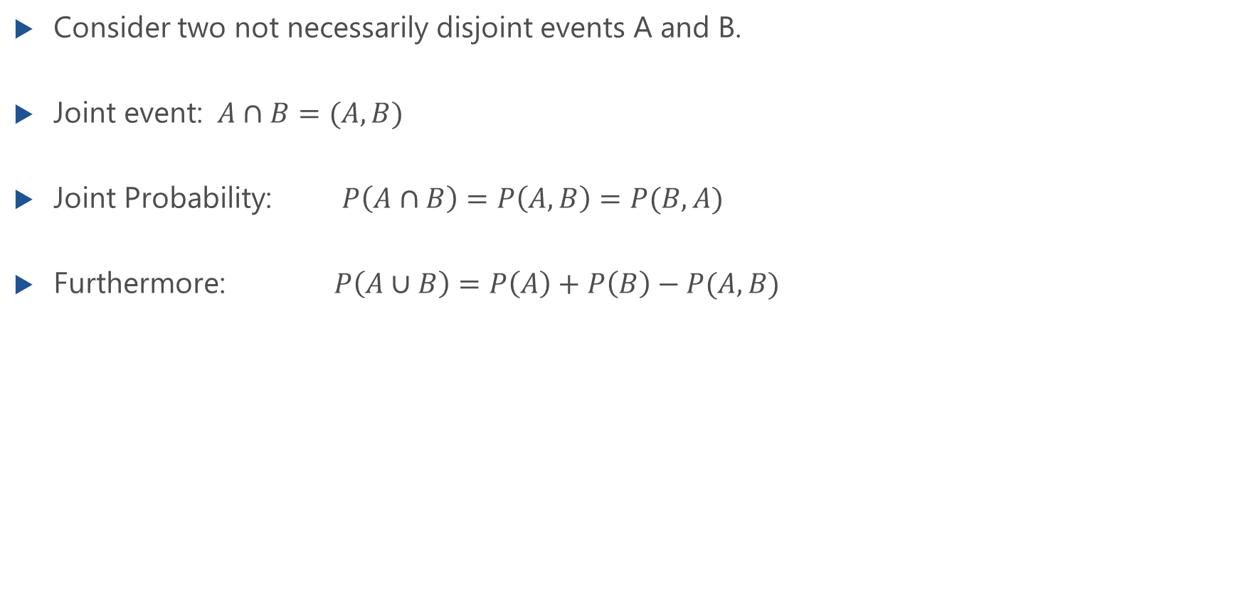
Joint Probability
Consider two not necessarily disjoint events A and B.
Joint event: $A∩B=(A,B)$
Joint Probability: $P\left(A∩B\right)=P\left(A,B\right)=P(B,A)$
Furthermore: $P\left(A∪B\right)=P\left(A\right)+P\left(B\right)−P(A,B)$
$$A∪B$$
$$A$$
$$B$$
$$A∩B$$

Slide 11
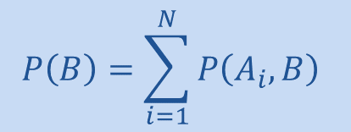
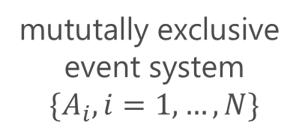


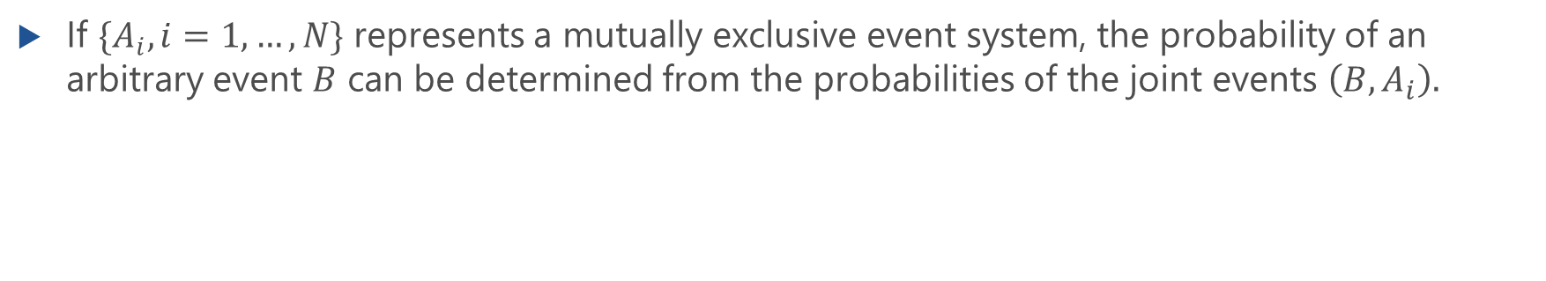
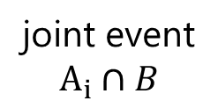
Joint Probability (f.)
mututally exclusive event system
$$\{A_{i}, i=1,…,N\}$$
sample space
$$Ω$$
A_{N}
A₁
A₂
...
...
$$B$$
A_{i}
joint event
$$A_{i}∩B$$
If $\{A_{i}, i=1,…,N\}$ represents a mutually exclusive event system, the probability of an arbitrary event $B$ can be determined from the probabilities of the joint events $\left(B,A_{i}\right).$
$$P\left(B\right)=\sum_{i=1}^{N}{P\left(A_{i},B\right)}$$

Slide 12
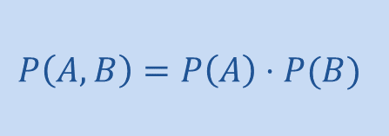
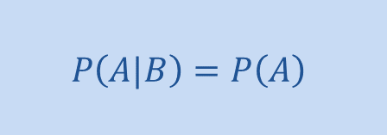
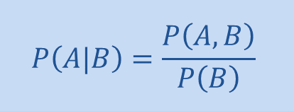
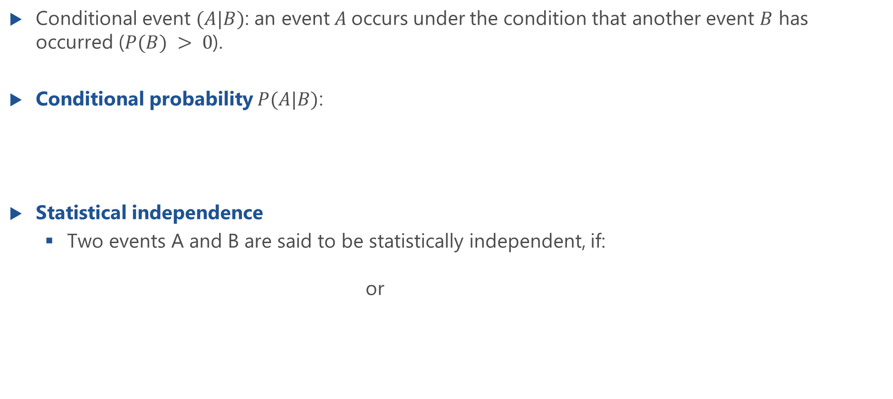
Conditional Probability and Statistical Independence
Conditional event $(A|B)$: an event$A$occurs under the condition that another event $B$ has occurred ($P(B) > 0$).
Conditional probability $P(A|B)$:
Statistical independence
Two events A and B are said to be statistically independent, if: or
$$P\left(A|B\right)=\frac{P\left(A,B\right)}{P\left(B\right)}$$
$$P\left(A|B\right)=P\left(A\right)$$
$$P\left(A,B\right)=P\left(A\right)⋅P(B)$$

Slide 13
Statistical Independence and Disjointness
Lecture

Slide 14
Example: Joint and Conditional Probability
Lecture

Slide 15
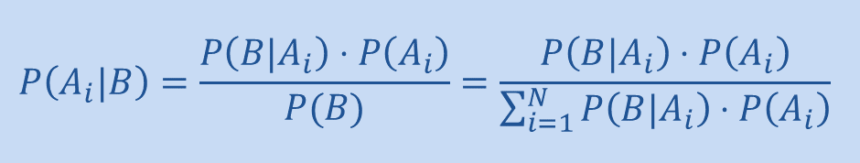
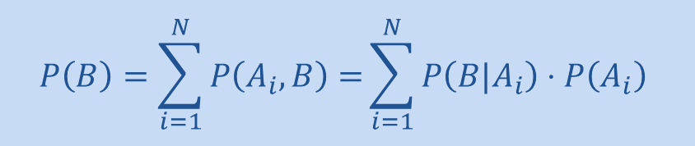
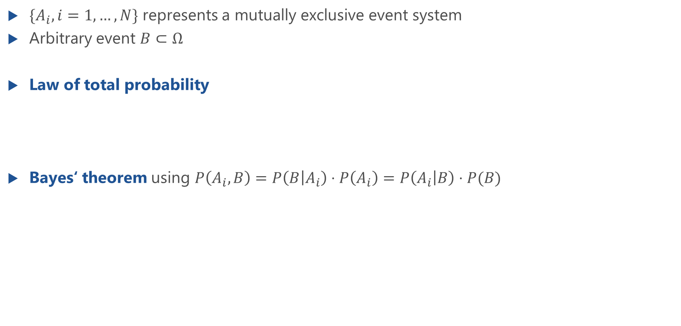
Law of Total Probability
$\{A_{i}, i=1,…,N\}$ represents a mutually exclusive event system
Arbitrary event $B⊂Ω$
Law of total probability
Bayes‘ theorem using $P\left(A_{i},B\right)=P\left(B | A_{i}\right)⋅P\left(A_{i}\right)=P\left(A_{i} | B\right)⋅P(B)$
$$P\left(B\right)=\sum_{i=1}^{N}{P\left(A_{i},B\right)=}\sum_{i=1}^{N}{P\left({B|A}_{i}\right)⋅P\left(A_{i}\right)}$$
$$P\left(A_{i}|B\right)=\frac{P\left({B|A}_{i}\right)⋅P\left(A_{i}\right)}{P(B)}=\frac{P\left({B|A}_{i}\right)⋅P\left(A_{i}\right)}{\sum_{i=1}^{N}{P\left({B|A}_{i}\right)⋅P\left(A_{i}\right)}}$$

Slide 16
Example: Bayes’ Theorem
Lecture

Slide 17
Random Variables (R.V.)
Random Variable, Distribution and Distribution Function

Slide 18
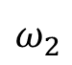
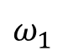
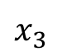
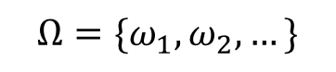
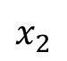
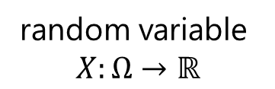
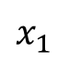
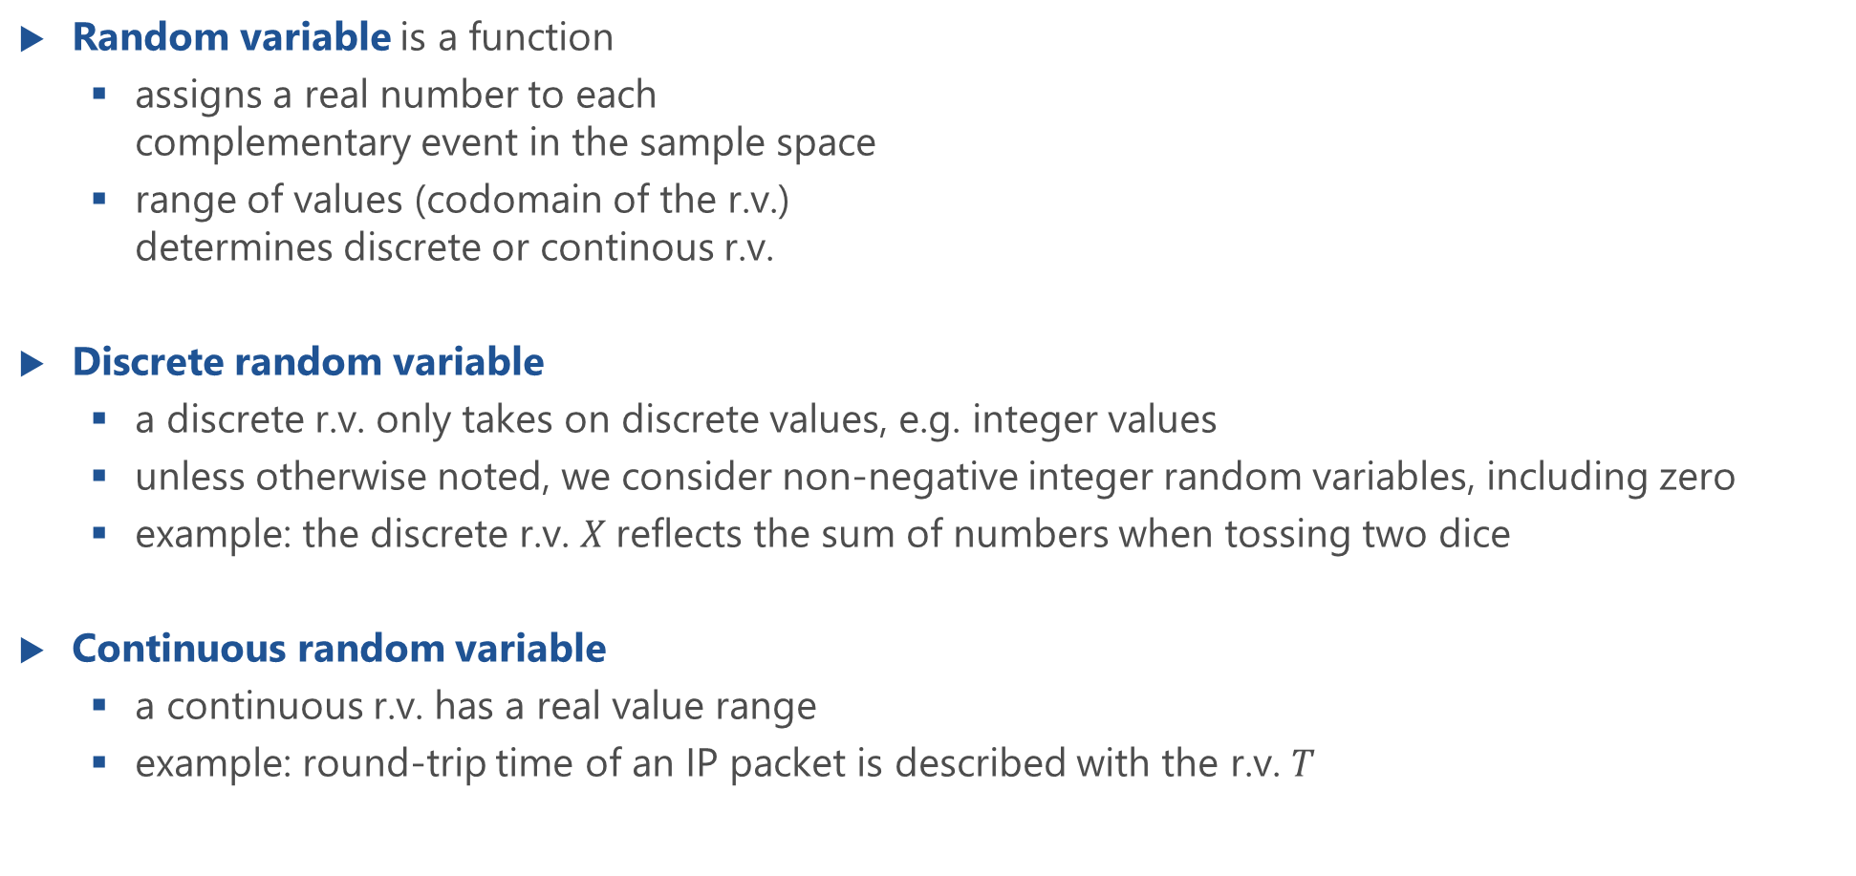
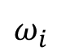
Random Variables (R.V.s)
$$Ω=\{ω_{1},ω_{2}, …\}$$
function
Random variable is a function
assigns a real number to each complementary event in the sample space
range of values (codomain of the r.v.) determines discrete or continous r.v.
Discrete random variable
a discrete r.v. only takes on discrete values, e.g. integer values
unless otherwise noted, we consider non-negative integer random variables, including zero
example: the discrete r.v. $X$reflects the sum of numbers when tossing two dice
Continuous random variable
a continuous r.v. has a real value range
example: round-trip time of an IP packet is described with the r.v. $T$
$$ω_{1}$$
$$x_{1}$$
$$ω_{2}$$
$$x_{2}$$
$$ω_{i}$$
$$x_{3}$$
random variable
$$X:Ω→ℝ$$

Slide 19
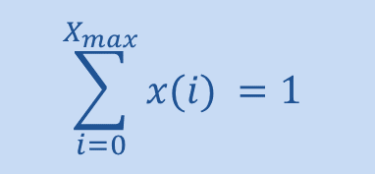
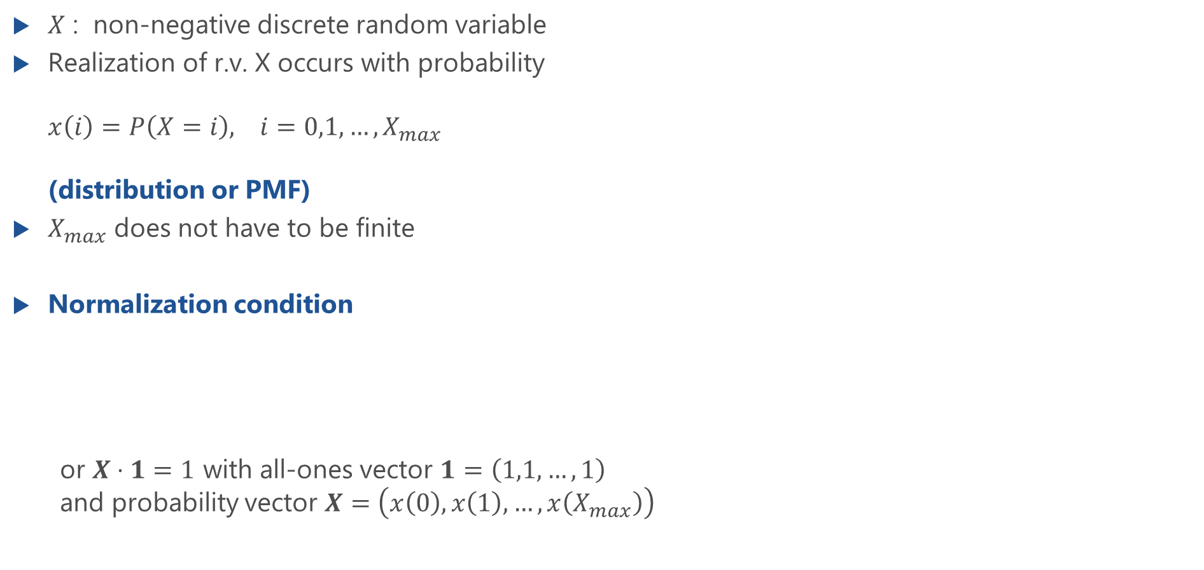
Distribution or Probability Mass Function (PMF)
$X$ : non-negative discrete random variable
Realization of r.v. X occurs with probability $x\left(i\right)=P\left(X=i\right), i=0,1,…,X_{max}$ (distribution or PMF)
$X_{max}$ does not have to be finite
Normalization condition
or $X⋅1=1$ with all-ones vector $1=\left(1,1,…,1\right)$ and probability vector $X=\left(x\left(0\right), x\left(1\right),…,x\left(X_{max}\right)\right)$
$$\sum_{i=0}^{X_{max}}{x(i) }=1$$

Slide 20
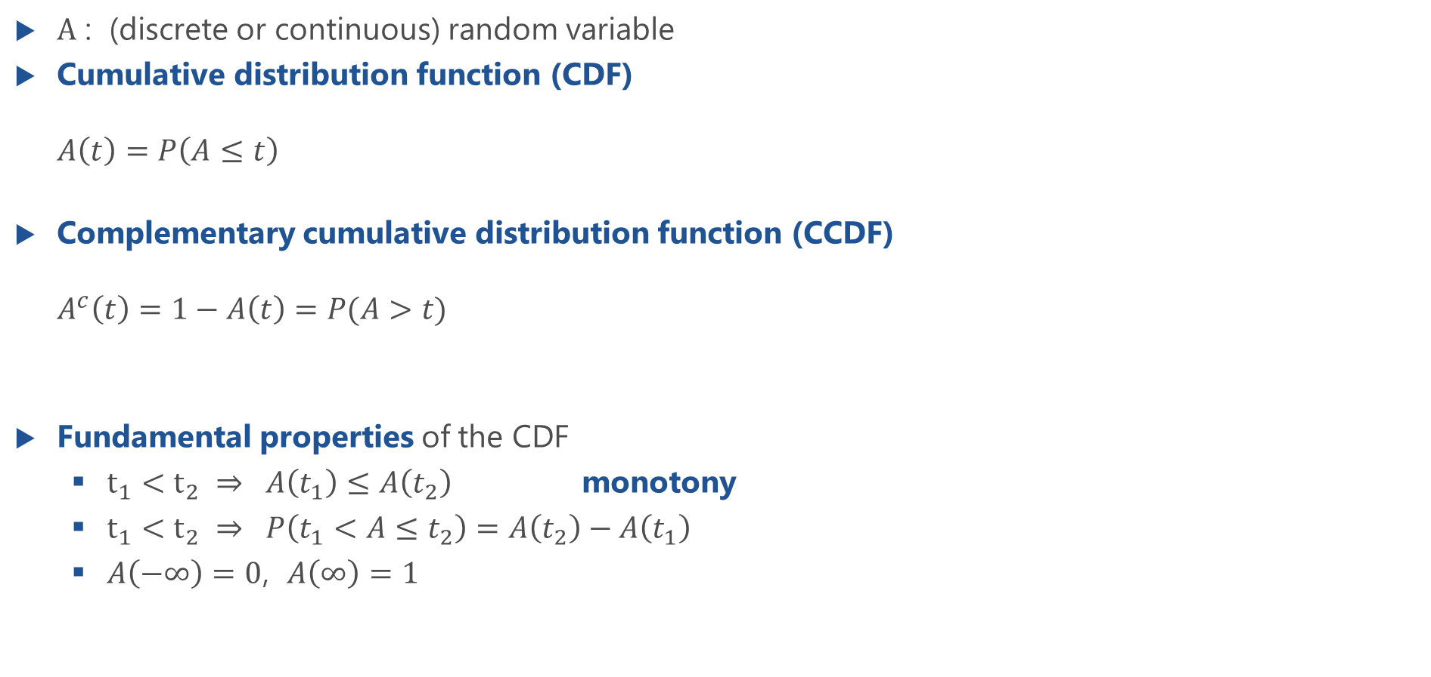
Cumulative Distribution Function (CDF)
$A$ : (discrete or continuous) random variable
Cumulative distribution function (CDF) $A\left(t\right)=P\left(A≤t\right)$
Complementary cumulative distribution function (CCDF) $A^{c}\left(t\right)=1−A\left(t\right)=P(A>t)$
Fundamental properties of the CDF
$t_{1}<t_{2} ⇒ A\left(t_{1}\right)≤A\left(t_{2}\right)$ monotony
$t_{1}<t_{2} ⇒ P\left(t_{1}<A≤t_{2}\right)=A\left(t_{2}\right)−A\left(t_{1}\right)$
$A\left(−∞\right)=0$, $A\left(∞\right)=1$

Slide 21
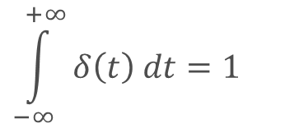
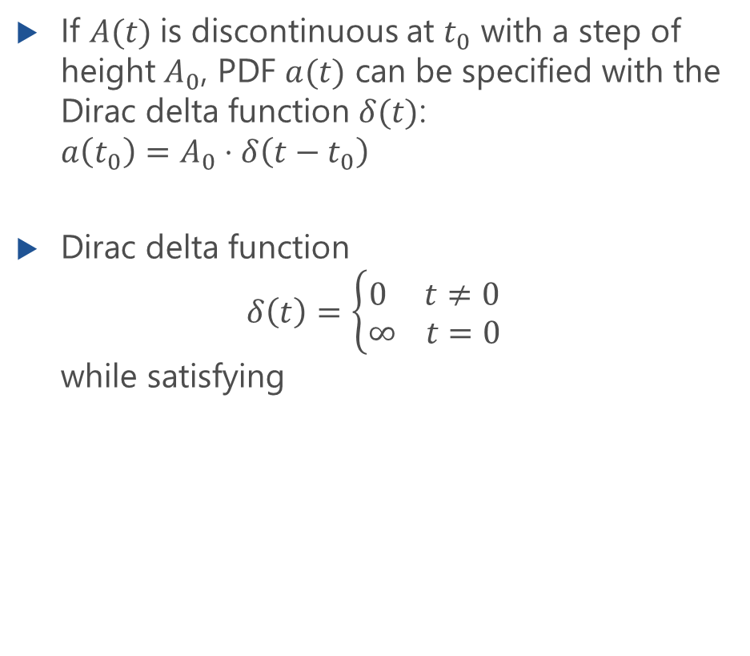
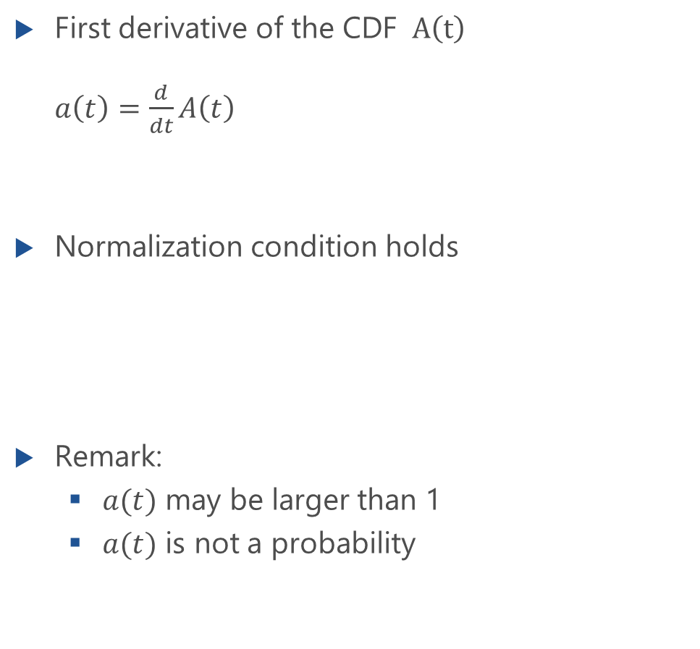
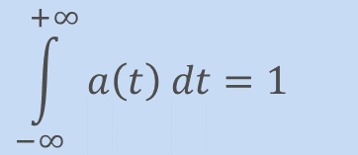
Probability Density Function (PDF)
First derivative of the CDF $A\left(t\right)$ $a\left(t\right)=\frac{d}{dt}A\left(t\right)$
Normalization condition holds
Remark:
$a(t)$ may be larger than 1
$a(t)$ is not a probability
If $A(t)$is discontinuous at $t_{0}$ with a step of height $A_{0}$, PDF $a(t)$ can be specified with the Dirac delta function $δ(t)$: $a\left(t_{0}\right)=A_{0}⋅δ\left(t−t_{0}\right)$
Dirac delta function $δ\left(t\right)=\left\{\begin{aligned}0 t≠0 \\ ∞ t=0\end{aligned}\right.$ while satisfying
$$\int_{−∞}^{+∞}{a\left(t\right) dt=1}$$
$$\int_{−∞}^{+∞}{δ\left(t\right) dt=1}$$

Slide 22
Illustration of CDF and PDF

Slide 23
Probability Density
Lecture

Slide 24
Example: Exponential Distribution
Lecture

Slide 25
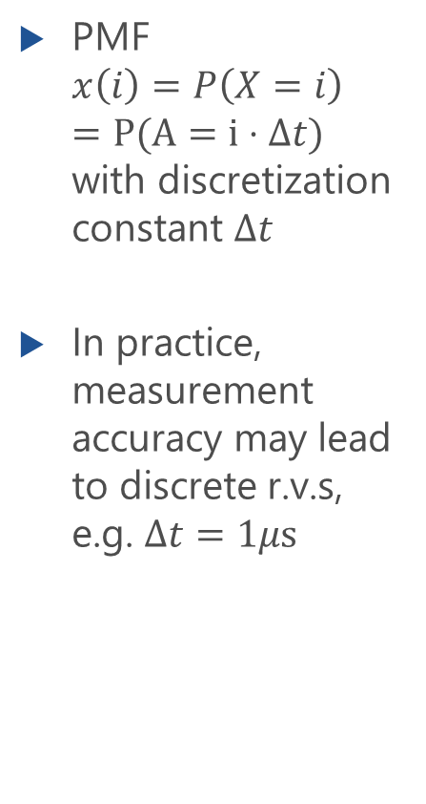
Discrete R.V.
PMF $x\left(i\right)=P\left(X=i\right)$ $=P(A=i⋅Δt)$ with discretization constant $Δt$
In practice, measurement accuracy may lead to discrete r.v.s, e.g. $Δt=1μs$

Slide 26
Expected Value and Moments
Expected value, variance, standard deviation, coefficient of variation

Slide 27
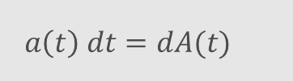
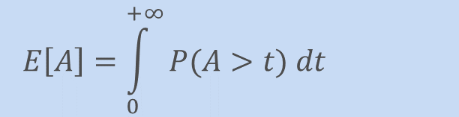
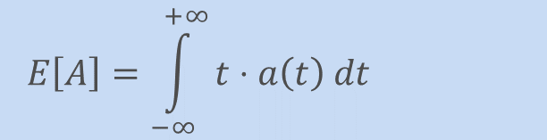
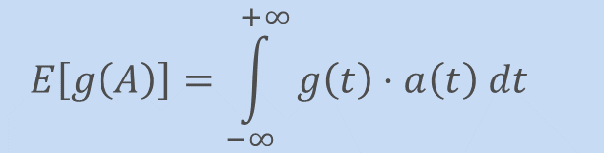
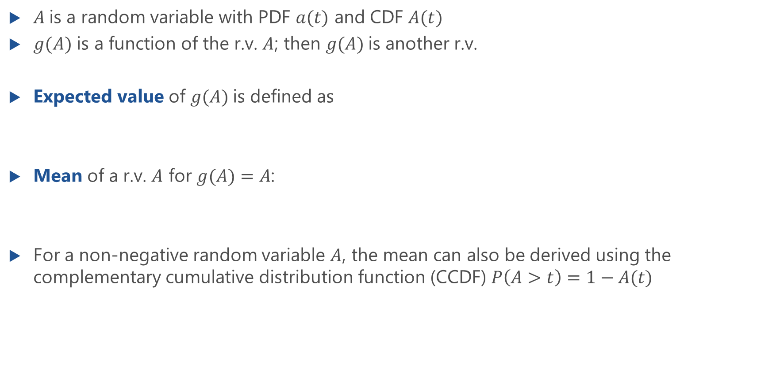
Expected Value and Mean of a Random Variable
$A$is a random variable with PDF $a(t)$ and CDF $A(t)$
$g(A)$ is a function of the r.v. $A$; then $g(A)$is another r.v.
Expected value of $g(A)$is defined as
Mean of a r.v. $A$ for $g(A)=A$:
For a non-negative random variable $A$, the mean can also be derived using the complementary cumulative distribution function (CCDF) $P\left(A>t\right)=1−A(t)$
$$E\left[g\left(A\right)\right]=\int_{−∞}^{+∞}{g\left(t\right)⋅a\left(t\right) dt}$$
$$E\left[A\right]=\int_{−∞}^{+∞}{t⋅a\left(t\right) dt}$$
Another notation
$$a\left(t\right) dt=dA(t)$$
$$E\left[A\right]=\int_{0}^{+∞}{P(A>t) dt}$$

Slide 28
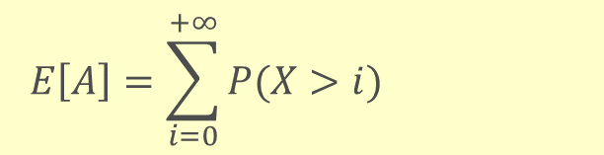
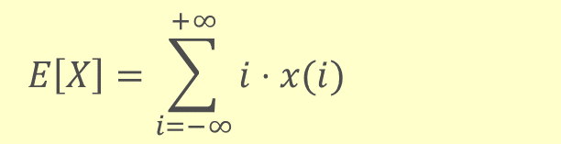


Expected Value and Mean of a Discrete Random Variable
$X$is a discrete random variable with PMF $x(i)$ and CDF $X(i)$
$g(X)$ is a function of the r.v. $X$; then $g(X)$is another r.v.
Expected value of $g(X)$is defined as
Mean of a r.v. $X$ for $g(X)=X$:
For a non-negative random variable $X$, the mean can also be derived using the complementary cumulative distribution function (CCDF) $P\left(X>i\right)=1−X(i)$
$$E\left[g\left(X\right)\right]=\sum_{i=−∞}^{+∞}{g\left(i\right)⋅x(i)}$$
$$E\left[X\right]=\sum_{i=−∞}^{+∞}{i⋅x(i)}$$
$$E\left[A\right]=\sum_{i=0}^{+∞}{P(X>i) }$$

Slide 29
CCDF and Mean Value
Lecture

Slide 30



(Ordinary) Moments and Central Moments
$k$-th (ordinary) moment: expected value of $g(A) = A^{k}$ for $k=0,1,2,…$
$k$-th central moment: expected value of $g(A) ={\left(A−m_{1}\right)}^{k}$ for $k=0,1,2,…$
$$m_{k}=E\left[A^{k}\right]=\int_{−∞}^{+∞}{t^{k}⋅a\left(t\right) dt}$$
$$μ_{k}=E\left[{\left(A−m_{1}\right)}^{k}\right]=\int_{−∞}^{+∞}{{\left(t−m_{1}\right)}^{k}⋅a\left(t\right) dt}$$

Slide 31




Variance, Standard Deviation, Coefficient of Variation
Variance (second central moment)
Standard deviation
Coefficient of variation
$$VAR\left[A\right]=μ_{2}=E\left[{\left(A−m_{1}\right)}^{2}\right]=E\left[A^{2}−2m_{1}A+m_{1}^{2}\right]$$ $=E\left[A^{2}\right]−2m_{1}E\left[A\right]+m_{1}^{2}=E\left[A^{2}\right]−E{\left[A\right]}^{2}$
with $m_{1} = E[A]$
$$VAR\left[A\right]=E\left[A^{2}\right]−E{\left[A\right]}^{2}$$
$$STD\left[A\right]=σ_{A}=\sqrt{VAR[A]}$$
$$c_{A}=\frac{σ_{A}}{μ_{A}}=\frac{STD\left[A\right]}{E[A]}$$

Slide 32
Functions of Random Variables and Inequalities
Functions of a single R.V., Jensen‘s inequality, Markov‘s inequality

Slide 33


Function of a Random Variable
Random variable $X$ is mapped to a r.v. $Y=f(X)$ with function $X$ with inverse function $f^{−1}$
r.v. $Y=f(X)$
CDF $Y\left(t\right)=P\left(Y≤t\right)=P\left(f\left(X\right)≤t\right)=P\left(X≤f^{−1}\left(t\right)\right)=X\left(f^{−1}\left(t\right)\right)$
PDF $y\left(t\right)=\frac{d}{dt}Y\left(t\right)$
Example 1: energy consumption $Y$ is a linear function of the sojourn time $W$ of IoT packets when transmitting over the air interface, $Y=f\left(W\right)=aW+b$ with constants $a,b$
Example 2: number of video stalls $X$ is mapped to QoE $Y$ with nonlinear function, $Y=f(X)$
In general:
$$E\left[Y\right]=E\left[f\left(X\right)\right]≠f\left(E\left[X\right]\right)$$

Slide 34
Example
Lecture

Slide 35


Jensen‘s Inequality for Mean Values
Jensen‘s inequality is valid for discrete and continuous r.v.s
$f\left(E\left[X\right]\right)≤E\left[f\left(X\right)\right]$ for convex function $f$
$f^{′}\left(x\right)=\frac{d}{dx}f\left(x\right)$ is monotonically decreasing or
$f^{′′}\left(x\right)≤0$ for a convex function
$f\left(E\left[X\right]\right)≥E\left[f\left(X\right)\right]$ for concave function $f$
$f^{′}\left(x\right)=\frac{d}{dx}f\left(x\right)$ is monotonically increasing or
$f^{′′}\left(x\right)≥0$ for a concave function
Linear function $f\left(x\right)=ax+b$: Then $E\left[f\left(X\right)\right]=E\left[aX+b\right]=aE\left[X\right]+b=f\left(E\left[X\right]\right)$

Slide 36
Example: Network Throughput
Lecture

Slide 37
Example: QoE of Video Streaming
Lecture

Slide 38


Markov‘s Inequality
Relation between the probability that a non-negative random variable is larger than a certain value $a > 0$ and its mean value.
Markov‘s Inequality
$P\left(X≥a\right) ≤ \frac{E\left[X\right]}{a}$ for $a>0$and $E[X]<∞$
Probability that the random variable is larger than the c-fold of the mean value $P\left(X≥cE\left[X\right]\right) ≤ \frac{1}{c}$
Note: No information on the distribution is requierd
factor c

Slide 39
Functions of Two Random Variables
Moments, correlation coefficient, sum, difference, maximum, minimum of r.v.s

Slide 40







Two-dimensional Random Variables
General case: multi-dimensional r.v.s with $A_{1}, A_{2}, …, A_{i}$arbitray, non-negative r.v.s
joint event: $\left\{A_{1}≤t_{1},A_{2}≤t_{2},…,A_{i}≤t_{i}\right\}$
joint CDF: $A\left(t_{1},t_{2},…,t_{i}\right)=P\left(A_{1}≤t_{1},A_{2}≤t_{2},…,A_{i}≤t_{i}\right)$
Two-dimensional r.v. $A=(A_{1},A_{2})$
with joint cumulative distribution function and joint density function
marginal cumulative distribution function for the limits $t_{1}→∞$ or $t_{2}→∞$
marginal probability density function for the limits $t_{1}→∞$ or $t_{2}→∞$
$$A\left(t_{1},t_{2}\right)=P\left(A_{1}≤t_{1},A_{2}≤t_{2}\right)$$
$$a\left(t_{1},t_{2}\right)=\frac{∂^{2}A(t_{1},t_{2})}{∂t_{1} ∂t_{2}}$$
$$A_{1}\left(t_{1}\right)=\lim_{t_{2}→∞}A\left(t_{1},t_{2}\right)⁡$$
$$A_{2}\left(t_{2}\right)=\lim_{t_{1}→∞}A\left(t_{1},t_{2}\right)⁡$$
$$a_{1}\left(t_{1}\right)=\frac{d}{dt_{1}}A_{1}\left(t_{1}\right)$$
$$a_{2}\left(t_{2}\right)=\frac{d}{dt_{2}}A_{2}\left(t_{2}\right)$$

Slide 41

Example
Lecture

Slide 42



Two-dimensional Random Variables (f.)
Definition of an event $R=\left\{t_{11}<A_{1}≤t_{12},t_{21}<A_{2}≤t_{22}\right\}$
Probability of event $R$: $P\left(R\right)=A\left(t_{12},t_{22}\right)−A\left(t_{12},t_{21}\right)−A\left(t_{11},t_{22}\right)+A\left(t_{11},t_{21}\right)$
Computation with joint density
A(t₁₁,t₂₁)
t₁₁
t₁₂
A₁
A(t₁₂,t₂₁)
A(t₁₁,t₂₂)
t₂₁
R
$$a\left(t_{1},t_{2}\right)=\frac{∂^{2}A(t_{1},t_{2})}{∂t_{1} ∂t_{2}}$$
t₂₂
$$P\left(R\right)=P\left(t_{11}<A_{1}≤t_{12},t_{21}<A_{2}≤t_{22}\right) \\ =\int_{t_{2}=t_{21}}^{t_{22}}{\left(\int_{t_{1}=t_{11}}^{t_{12}}{a\left(t_{1},t_{2}\right) dt_{1}}\right)dt_{2}}$$
A₂

Slide 43


Visualization
Notebook in WueCampus or at https://modeling.systems

Slide 44


Properties of Two-dimensional R.V.s
Properties
Moments
moment of $\left(k_{1},k_{2}\right)$-th order
central moment of $\left(k_{1},k_{2}\right)$-th order

Slide 45
Covariance and Correlation Coefficient
Covariance
Correlation Coefficient

Slide 46
Calculation Rules for R.V.s
Lecture

Slide 47
Example: Linear Transformation
Lecture

Slide 48

Statistical Dependence and Correlation
Covariance
For two statistically independent r.v.s
covariance and correlation coefficient vanish: $COV[A_{1},A_{2}]=0$ and $r=0$
Note: statistical independence implies uncorrelation
Conversely, the uncorrelated nature of two stochastic processes does not always result in statistical independence

Slide 49

Sum of Random Variables
$A=A_{1}+A_{2}$

Slide 50

Sum of Two Continuous R.V.s
Given $A$ is the sum of two non-negative random variables $A_{1}$ and $A_{2}$ with $A_{1},A_{2}≥0$ $A=A_{1}+A_{2}$
Joint density function $a(t_{1},t_{2})$ and marginal density functions $a_{1}\left(t\right)$and $a_{2}\left(t\right)$
CDF follows by integrating over the triangle
Note: $A_{1}$and $A_{2}$ can be statistically dependent on each other.

Slide 51


Sum of Two Continuous R.V.s: Mean and Variance
Mean
Second Moment
Variance
$$E\left[A\right]=E\left[A_{1}\right]+E\left[A_{2}\right]$$
$$VAR\left[A\right]=VAR\left[A_{1}\right]+VAR\left[A_{2}\right] \\ +2COV[A_{1},A_{2}]$$

Slide 52


Special Case: Statistically Independent R.V.s
If $A_{1}$ and $A_{2}$ are statistically independent of each other, their joint density function is the product of the marginal density functions
For $A=A_{1}+A_{2}$, it is
We obtain
Both notations $a_{1}\left(t\right)∗a_{2}\left(t\right)$ and $\left(a_{1}∗a_{2}\right)\left(t\right)$ are common.
Convolution is an operation between functions (not between numbers)
$$a\left(t_{1},t_{2}\right)=a_{1}(t_{1})⋅a_{2}\left(t_{2}\right)$$
(continuous) convolution

Slide 53

Special Case: Statistically Independent R.V.s (f.)
Mean
Variance but $COV\left[A_{1},A_{2}\right]=0$
In general

Slide 54




Summary: Sum of Two Statistically Independent R.V.s
Sum of two statistically independent r.v.s
PDF of the sum obtained by convolution
Mean is also valid for dependent r.v.s
Variance for independent r.v.s
$$A=A_{1}+A_{2}$$
$$E[A]=E[A_{1}]+E[A_{2}]$$
$$a\left(t\right)=a_{1}\left(t\right)∗a_{2}\left(t\right)=(a_{1}∗a_{2})(t)$$
$$VAR[A]=VAR[A_{1}]+VAR[A_{2}]$$

Slide 55












Example: Transmission Delays
$$X_{1}$$
$$+$$
$$X_{2}$$
$$+$$
$$X_{3}$$
Access Network
Cloud / DC
Core Network
Access Network
Cloud / DC

Slide 56


Sum of Discrete Random Variables
$X$is the sum of two independent non-negative discrete random variables $X_{1}$ and $X_{2}$ $X=X_{1}+X_{2}$
Distribution of X
Discrete convolution
$$x\left(i\right)=x_{1}\left(i\right)∗x_{2}\left(i\right)=(x_{1}∗x_{2})(i)$$

Slide 57
Example: Sum of Bernoulli Distributions
Lecture

Slide 58

Difference, Minimum, Maximum of R.V.s
$A=A_{1}−A_{2}, A=\min\left(A_{1},A_{2}\right), A=\max\left(A_{1},A_{2}\right)$

Slide 59


Difference of Discrete Random Variables
Difference $X$ of two independent non-negative discrete random variables $X_{1}$ and $X_{2}$ $X=X_{1}−X_{2}$
Distribution of $X$ where $x\left(i\right)$ can exist for negative values of $i$
Notation with discrete convolution
$$x\left(i\right)=x_{1}\left(i\right)∗x_{2}\left(−i\right)=(x_{1}∗−x_{2})(i)$$

Slide 60


Maximum of Random Variables
Let $A$ be the maximum of two statistically independent random variables: $A=max⁡(A_{1},A_{2})$
Maximum can be formulated as follows: $\left\{A≤t\right\} for \left\{A_{1}≤t and A_{2}≤t\right\}$ $P\left(A≤t\right)=P\left(A_{1}≤t\right)⋅P\left(A_{2}≤t\right)$
Thus, we obtain $A\left(t\right)=A_{1}\left(t\right)⋅A_{2}\left(t\right)$ $a\left(t\right)=\frac{d}{dt}A\left(t\right)=a_{1}\left(t\right)A_{2}\left(t\right)+a_{2}\left(t\right)A_{1}(t)$
For $k$ statistically independent r.v.s:
$$A=\max\left(A_{1},A_{2},…,A_{k}\right)$$
$$A(t)=\prod_{i=1}^{k}{A_{i}\left(t\right)}$$

Slide 61


Minimum of Random Variables
Let $A$ be the minimum of two statistically independent random variables: $A=min⁡(A_{1},A_{2})$
Minimum can be formulated as follows: $\left\{A>t\right\} for \left\{A_{1}>t and A_{2}>t\right\}$ $P\left(A>t\right)=P\left(A_{1}>t\right)⋅P\left(A_{2}>t\right)$
Thus, we obtain $1−A\left(t\right)=(1−A_{1}\left(t\right))⋅(1−A_{2}\left(t\right))$ $A\left(t\right)=1−(1−A_{1}\left(t\right))⋅(1−A_{2}\left(t\right))$
For $k$ statistically independent r.v.s:
$$A=\min\left(A_{1},A_{2},…,A_{k}\right)$$
$$A\left(t\right)=1−\prod_{i=1}^{k}{\left(1−A_{i}\left(t\right)\right)}$$

Slide 62
Minimum of Exponential Distributions
Lecture

